Slide 1
PLANT DISEASE PREDICTION AND FERTILIZER RECOMMENDATION

Slide 2
ABSTRACT
This study employs the InceptionV3 deep learning architecture to predict leaf diseases in plants and recommend suitable fertilizers based on detected conditions.
Leveraging the power of YOLO algorithm, the model is trained on a comprehensive dataset of diseased and healthy plant leaves to accurately differentiate various leaf diseases.
The system provides high-accuracy disease detection, enabling early diagnosis and intervention in agricultural settings.
Additionally, the model suggests appropriate fertilizers tailored to the identified disease, aiding in effective crop management.
This research represents a significant advancement in precision agriculture, offering a proactive approach to disease mitigation and soil health optimization.

Slide 3
INTRODUCTION
Ensuring plant health is essential for maximizing agricultural productivity, as leaf diseases can significantly impact crop yields.
Traditional disease detection methods are often slow and inaccurate, requiring expert knowledge. To address this challenge, deep learning has emerged as a powerful tool for automated disease identification.
This study utilizes the InceptionV3 architecture to predict plant leaf diseases with high accuracy while also recommending appropriate fertilizers based on the detected disease.
By providing farmers with an efficient, AI-driven solution, this system enhances precision agriculture, enabling early intervention, improved crop health, and optimized soil management, ultimately leading to higher productivity

Slide 4
EXISTING SYSTEM
CNN based architecture is proposed in the existing methods. The CNN algorithm works well in image classifications.
There are 3 type of disease has been classified in the Existing architecture. Bacterial leaf blight, Brown spot, Leaf smut are the diseases.
The accuracy of the existing method is 90 %.

Slide 5
MY SOLUTION BASED PROBLEM STATEMENT
Plant diseases significantly threaten agricultural productivity, leading to reduced yields and economic losses.
Traditional disease detection methods are time-consuming, labor-intensive, and often inaccurate. Farmers also struggle with choosing the right fertilizers to restore plant health.
To address these challenges, this study proposes an AI-driven solution using the InceptionV3 deep learning model to accurately detect plant leaf diseases such as Brown Spot, Mildew, Blight, and Rust.
Additionally, the system recommends appropriate fertilizers based on the detected disease, aiding in effective crop recovery. This proactive approach enhances precision agriculture, ensuring early intervention, improved plant health, and optimized farming practices

Slide 6
PROPOSED SYSTEM
The proposed system utilizes InceptionV3, a deep learning-based to accurately detect plant leaf diseases such as Brown Spot, Mildew, Blight, and Rust.
By analyzing images of diseased leaves, the model identifies infections with high precision.
Additionally, the system provides fertilizer recommendations tailored to the detected disease, assisting farmers in effective crop recovery.
The model is integrated into a user-friendly interface, making it accessible for real-time diagnosis and decision-making.
This approach enhances precision agriculture by enabling early disease detection, proactive intervention, and improved crop management, ultimately contributing to higher yields and sustainable farming.

Slide 7
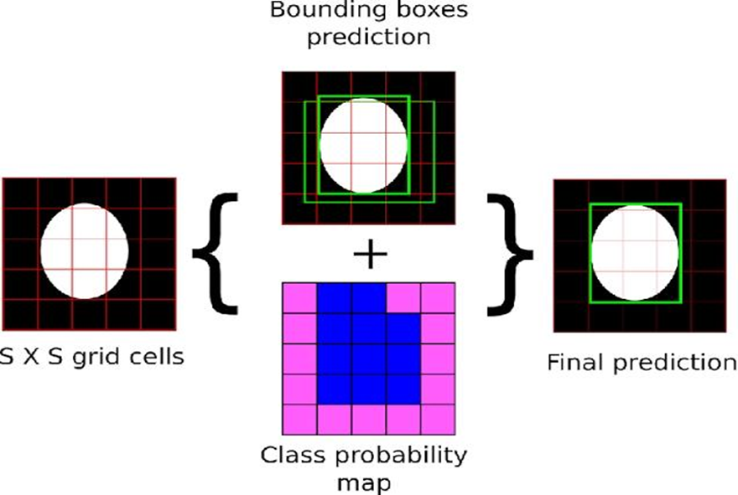
YOLO ALGORITHM
The YOLO algorithm divides the input image into a grid of cells, and for each cell, it predicts the probability of the presence of an object and the bounding box coordinates of the object. It also predicts the class of the object.

Slide 8
SOFTWARE REQUIREMENTS
FORNTEND:
HTML
CSS
BACKEND:
PYTHON(LANGUAGE)
FLASK(FRAMEWORK)

Slide 9
REQUIRED PYTHON MODULES
FLASK
Flask, render_template, request, url_for, send_from_directory
Used for building web routes, handling file uploads, rendering templates.
Os
For file path manipulation and directory checks
cv2 (OpenCV)
Reads and writes image files, used for drawing bounding boxes.
g4f.client
Client: For calling GPT-based responses via gpt-4o-mini.
collections
Counter: To count detected class names from YOLO results.

Slide 10
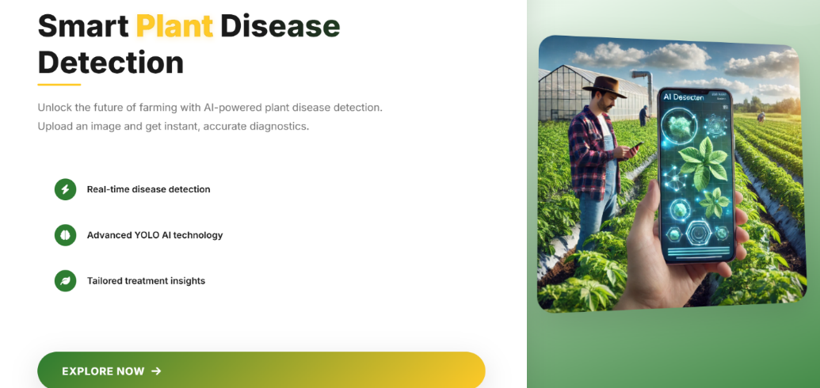
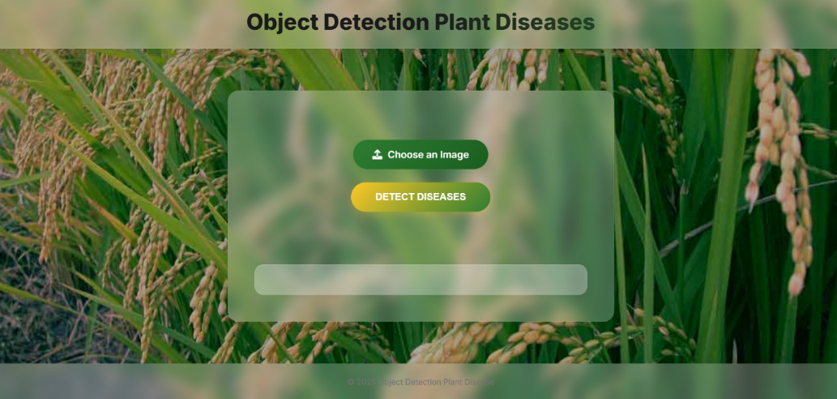
SCREENSHOT
HOME PAGE
IMAGE UPLOADING PAGE

Slide 11
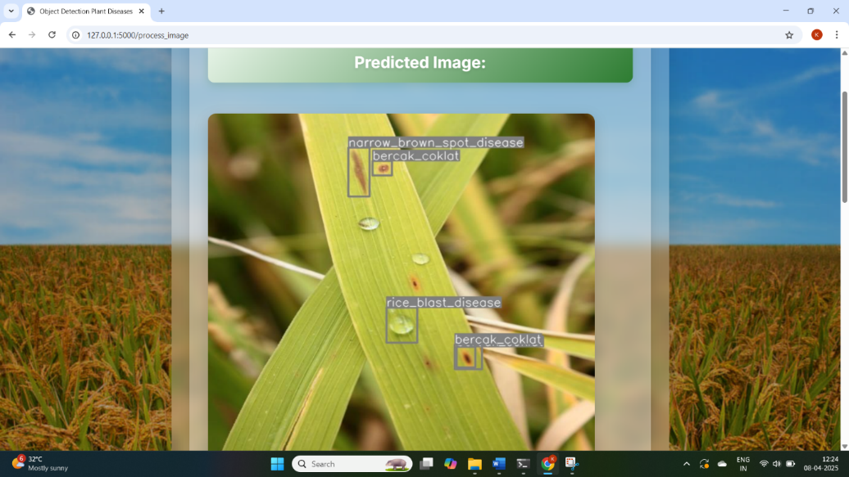
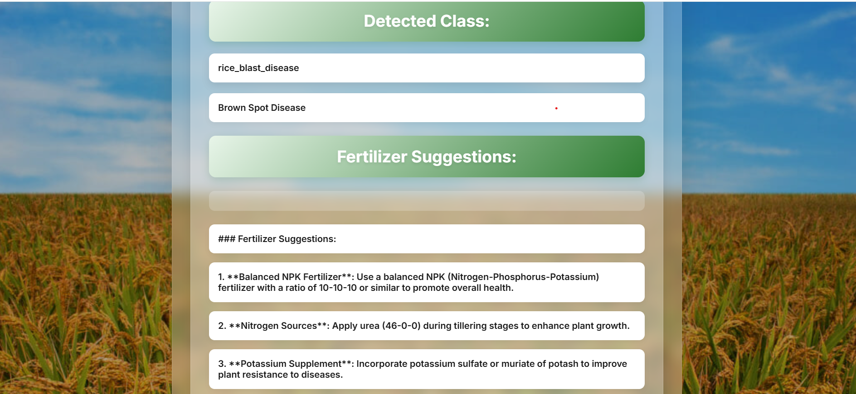
The system detects plant diseases using object detection technology.
The image displays rice leaves affected by multiple diseases.
Bounding boxes are drawn to highlight infected areas.
Detected Diseases:
Narrow Brown Spot Disease (bercak_coklat).
Rice Blast Disease (bercak_coklat)
FERTILIZER SUUGGESTION
Using GPT model

Slide 12
CONCLUSION
The Plant Disease Prediction and Fertilizer Recommendation system is a powerful AI-driven tool that combines computer vision and natural language processing to support farmers in maintaining healthy crops. By using YOLOv8 for accurate rice plant disease detection and GPT-based models for providing expert fertilizer and care recommendations, this application brings modern technology directly to the agricultural field.
It enhances early disease diagnosis, promotes targeted treatment, and helps farmers make informed decisions, ultimately aiming to increase yield and reduce unnecessary use of chemicals. With further improvements, this solution can be scaled to support other crops and languages, making it a valuable asset in smart farming and sustainable agriculture.

Slide 13
THANK YOU

Slide 14
SYSTEM REQUIREMENTS
H/W System Configuration:-
PROCESS : INTEL® CORE™ I9-14900K 3.20 GHZ
RAM : 16 GB
HARD DISK : 1 TB
S/W System Configuration:-
Operating System : Windows 7 or 8
Front End : python Idle / Google Colab

